Slide 1
Software Evolution
Chapter 9 Software Engineering by Ian Sommerville

Slide 2
Contents
Evolution processes
Program evolution dynamics
Software maintenance
Legacy system management
Notes:
Book 3 –Chapter 9

Slide 3
Introduction
Software development does not stop when a system is delivered but continues throughout the lifetime of the system
After a system has been deployed, it inevitably has to change if it is to remain useful
Business changes and changes to user expectations generate new requirements for the existing software
Parts of the software may have to be modified to correct errors that are found in operation, to adapt it for changes to its hardware and software platform, and to improve its performance or other non-functional characteristic

Slide 4
Software change is inevitable
New requirements emerge when the software is used;
The business environment changes;
Errors must be repaired;
New computers and equipment is added to the system;
The performance or reliability of the system may have to be improved.
A key problem for organizations is implementing and managing change to their existing software systems.

Slide 5
Software Evolution Importance
Software evolution is important because organizations have invested large amounts of money in their software and are now completely dependent on these systems.
Their systems are critical business assets and they have to invest in system change to maintain the value of these assets.
Consequently, most large companies spend more on maintaining existing systems than on new systems development.
Based on an informal industry poll, Erlikh (2000) suggests that 85–90% of organizational software costs are evolution costs. Other surveys suggest that about two-thirds of software costs are evolution costs. For sure, the costs of software change are a large part of the IT budget for all companies.
Notes:
In some cases 90 % of software costs are due to Software Evolution

Slide 6
Importance
Useful software systems often have a very long lifetime.
For example, large military or infrastructure systems, such as air traffic control systems, may have a lifetime of 30 years or more. Business systems are often more than 10 years old. Software cost a lot of money so a company has to use a software system for many years to get a return on its investment

Slide 7
Types of Changes
Repair of Software Faults-Changing a system to correct deficiencies in the way meets its requirements.
Adapt software to a different operating environment-Changing a system so that it operates in a different environment (computer, OS, etc.) from its initial implementation.
Add to or modify the system’s functionality-Modifying the system to satisfy new requirements.
Improve the program structure and system performance-Modifying the system without changing functional behavior

Slide 8
Program evolution dynamics
Program evolution dynamics is the study of the processes of system change.
After major empirical studies, Lehman and Belady proposed that there were a number of ‘laws’ which applied to all systems as they evolved.
These are sensible observations rather than laws. They are applicable to large systems developed by large organizations.
Perhaps less applicable in other cases.

Slide 9
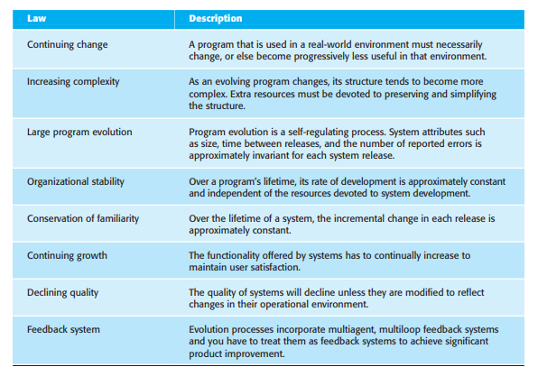
Lehman’s laws
Notes:
A multi-agent system (MAS) is a loosely coupled network of software agents that interact to solve problems that are beyond the individual capacities or knowledge of each problem solver.

Slide 10
Software Evolution
Broad definition of evolution:
Generally, software evolution refers to the study and management of the process of making changes to software over time.
In this definition, software evolution comprises:
Development activities
Maintenance activities
Reengineering activities

Slide 11
Software Maintenance: Overview
The activities of changing the system after it has been delivered
Types of software maintenance:
Corrective maintenance: repair of software faults
Adaptive maintenance: modification of software due to changes in the operating environment (hardware, supporting software)
Perfective maintenance: additions to and/or modifications of system functionality due to organizational or business changes
Notes:
Usually greater than development costs (2* to 100* depending on the application).Affected by both technical and non-technical factors.Increases as software changes accumulate. Changes corrupt the software structure making further maintenance more difficult.Ageing software can have high support costs (e.g. old languages, compilers etc.).

Slide 12
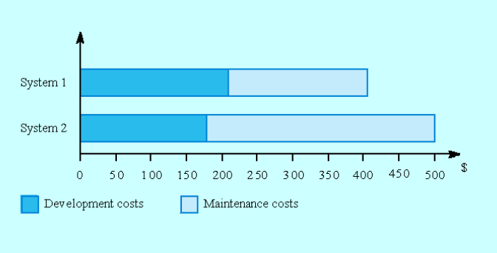
Development/Maintenance Cost

Slide 13
Maintenance Cost Factors
Team stability
Maintenance costs are reduced if the same staff are involved with them for some time.
Contractual responsibility
The developers of a system may have no contractual responsibility for maintenance so there is no incentive to design for future change.
Staff skills
Maintenance staff are often inexperienced and have limited domain knowledge
Program age and structure
As programs age, their structure is degraded and they become harder to understand and change.

Slide 14
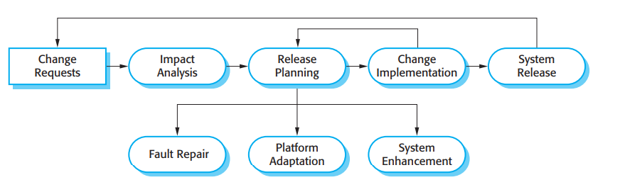
Software Evolution Process

Slide 15
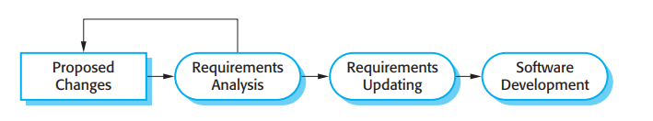
Change Implementation

Slide 16
Urgent Changes Request
Urgent changes may have to be implemented without going through all stages of the evolution process
If a serious system fault has to be repaired;
If changes to the system’s environment (e.g. an OS upgrade) have unexpected effects.
If there are business changes that require a very rapid response (e.g. the release of a competing product).

Slide 17
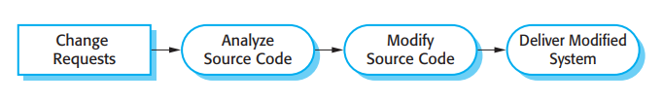
Emergency Repair Process

Slide 18
Legacy System
Older Systems that remain vital to an organization
Legacy systems are old systems that are still useful and are sometimes critical to business operation.
They may be implemented using outdated languages and technology or may use other systems that are expensive to maintain.
Often their structure has been degraded by change and documentation is missing or out of date.
Nevertheless, it may not be cost effective to replace these systems.
Notes:
hardware in power plants, manufacturing machines controlled by computers running MS-DOS, or outdated financial systems.
factory equipment that run on MS-DOS
MS-DOS is a command-line interface (CLI) operating system that does not have a graphical user interface (GUI) like Windows.

Slide 19
The legacy dilemma
It is expensive and risky to replace the legacy system
It is expensive to maintain the legacy system
Businesses must weigh up the costs and risks and may choose to extend the system lifetime using techniques such as re-engineering.

Slide 20
Software Re- engineering
It is a process of software development which is done to improve the maintainability of a software system.
Technical Definition: Software Re- engineering is the examination and alteration of a system to reconstitute it in a new form
Notes:
Reengineering=Reverse engineering +Delta Forward Engineering

Slide 21
Re-Engineering Cost Factors
The quality of the software to be re-engineered.
The tool support availability for engineering.
The extent of the data conversion which is required.
The availability of expert staff for Re-engineering.

